Slide 1
Unit 3: Text-Based Programming
Lesson 11

Slide 2
Looping
To get a computer to do the same thing over and over again, you don’t have to write the same code over and over again - you can use loops.
Looping and running the same code over and over again is known as iteration.

Slide 3
Iterables
An iterable is just something which can be “iterated”, or stepped through one bit at a time, such as a list of numbers or words
Though you may not have realised it, you have already used an iterable during this course: a string.
A string is a list of characters in an order: for example, “hello” is a list of 5 characters in the order “h” “e” “l” “l” “o”.

Slide 4
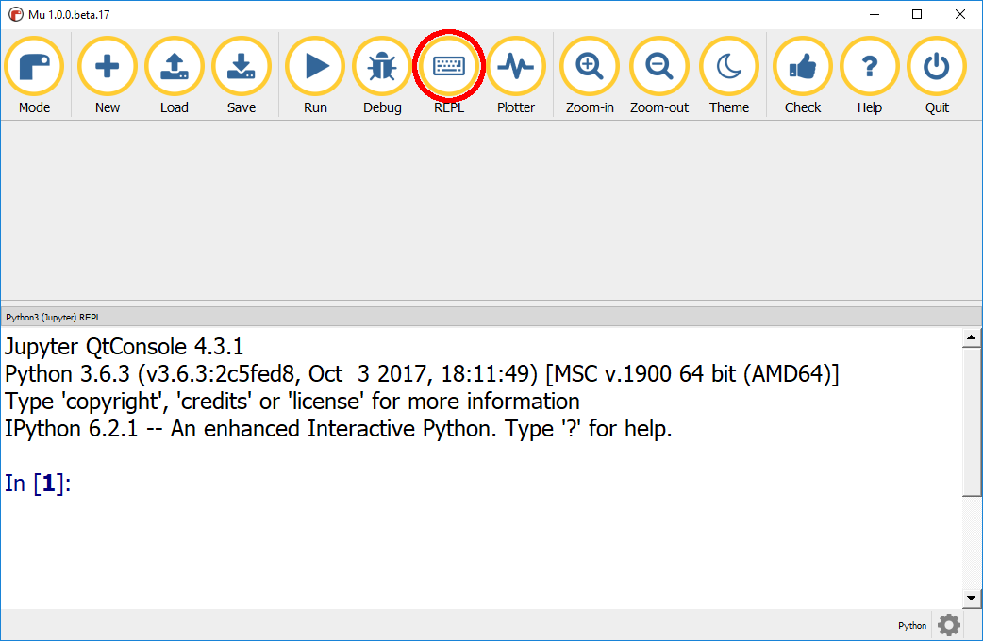
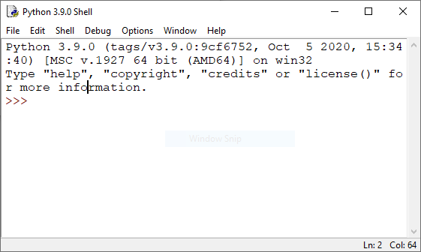
Strings as Iterables
Open the REPL in Mu or the Shell in IDLE.

Slide 5
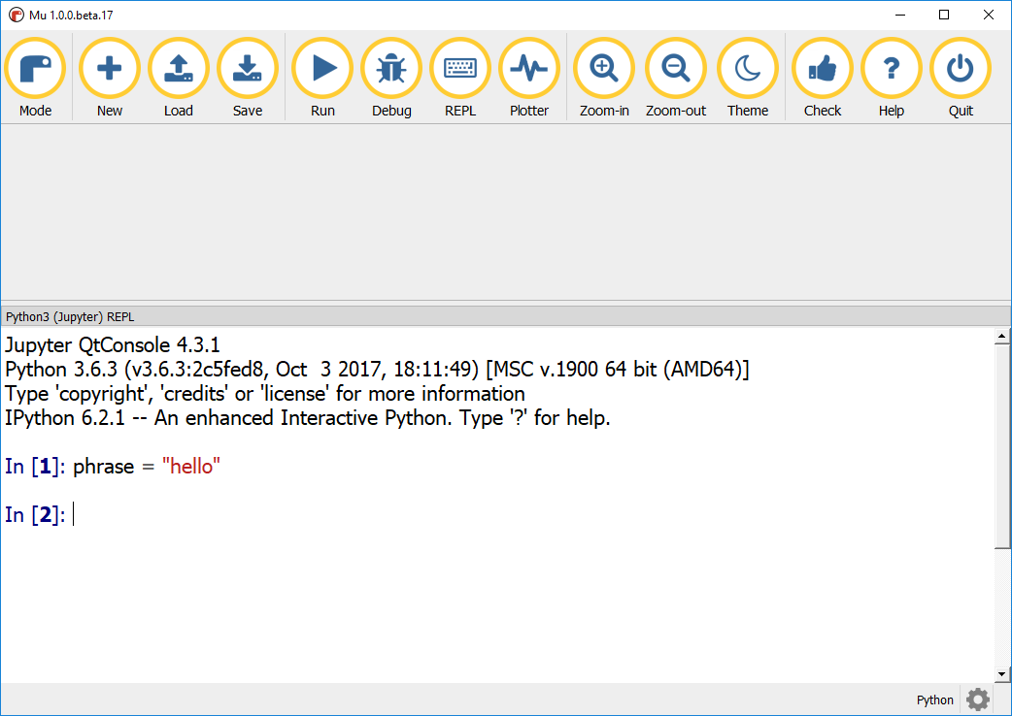
Create a string variable called phrase and assign it the value "hello", by typing the following into the REPL and pressing Enter.
phrase = “hello”

Slide 6
You can access individual elements (or items) in a list or split them up into parts by using indexes, an index being a position in a list.
The string hello has 5 characters, the first element being h which has an index of 0, the second element e has an index of 1 and so on: 0 1 2 3 4 h e l l o
Tip: It’s a controversial subject, but the majority of computer programmers agree that indexes should start at 0 and not 1, so it’s a good idea to embrace the idea that numbers start at zero!

Slide 7
You access elements in a list by using square brackets [] after the variable name, adding the index of the element you wish to get: variable[index]
Get the first character from your string variable by entering this into the REPL. phrase[0]

Slide 8
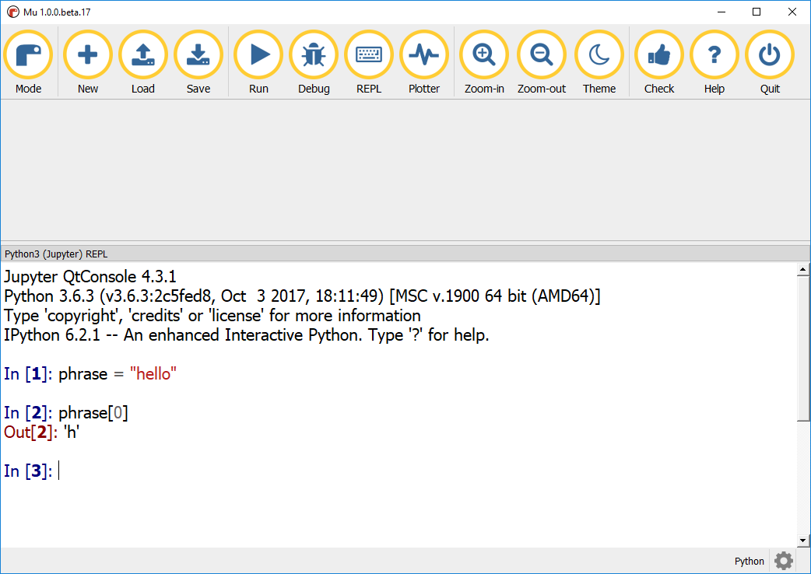

Slide 9
Challenge
Repeat the last step, changing the index to get the fourth character (“l”) in the string. Note: Indexes don’t have to be positive numbers. You can also use negative indexes to get elements from the end of the list. For example, the last element in a list would have the index of -1: -5 -4 -3 -2 -1 h e l l o

Slide 10
Get the last character from your string using the REPL. phrase[-1]
What do you think the advantage is of using phrase[-1] over using phrase[4] to get the last element?

Slide 11
Indexes and Slices
In addition to getting single elements from an iterable you can also use indexes to get “slices” of a list, such as the first three characters or the 3rd to 4th characters. To get a slice, you need to provide two indexes (the start and end of the slice you want), separated by a colon : inside square brackets: variable[start_index:end_index]

Slide 12
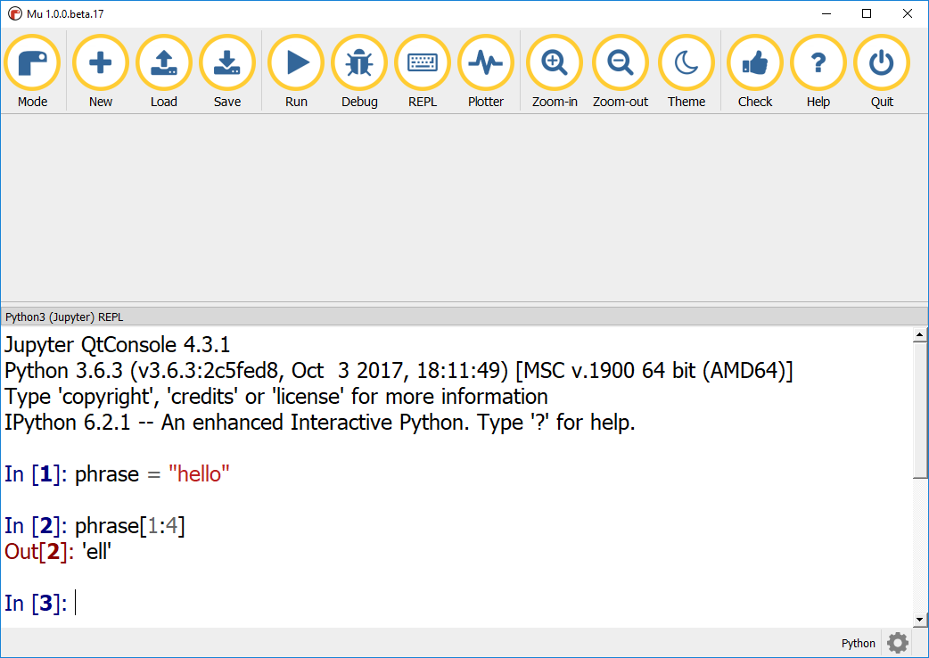
Get the middle three characters from the phrase variable. phrase[1:4]

Slide 13
Note: To get the middle 3 characters ell from hello you used phrase[1,4]. The element at index 4 is “o”, but “o” isn’t output. The end_index in a range is up to, but not including. 0 1 2 3 4 h e l l o - - - >

Slide 14
Challenge
Get the last two characters from the phrase variable. Tip: If you want to get a range which is from the start or up to the end of a list, you can leave the start or end index blank. For example, phrase[:3] phrase[3:]
Practice using ranges, create some longer strings and see how you can slice them up.

Slide 15
Lists
Python has a data type for storing lists, imaginatively called List. A list can store a sequence of any other pieces of data of any types (integers, strings, booleans, etc.). Note: Other programming languages might refer to lists as arrays. While they have a different name and their usage might also be different, conceptually they are the same.

Slide 16
You can create a list variable in Python in just the same way as any other variable: by giving it a name and assigning it a value. For a list, the value will be a sequence of elements to be put in the list, written between square brackets [] and separated by commas: my_list = [1, 2, 3, 4, 5] If you want to create an empty list, which you will put items to later in your program, you can use empty square brackets: []. my_list = [] Note: Lists can contain all different types of data: integers, strings, and anything else. They can even contain other lists.

Slide 17
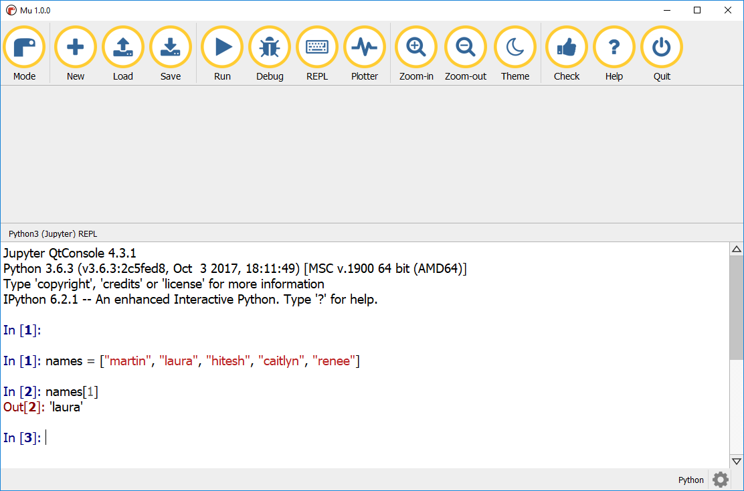
Create a list of names using the REPL. names = ["martin", "laura", "hitesh", "caitlyn", "renee"]
Using an index, as you did with a string, get the second name (index 1) from the list. names[1]

Slide 18
A feature of lists in Python is that they can be changed after they have been created: you can add new elements to the end of the list, insert them in the middle, or remove them completely using the three functions append, insert and remove. (As these are special list functions, they are joined with a dot to the name of the list they apply to, as in the examples below. Technically functions of this kind are called “methods”.)
Append a new name to the end of your list of names. names.append("lauren")
Check to make sure your new name has been appended to the end of your list. names

Slide 19
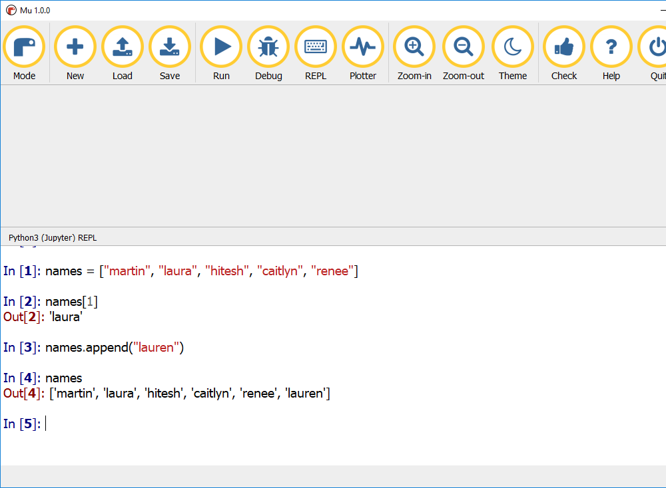

Slide 20
Next let’s use insert to put a new name in the middle of the list, by also using the index of where to insert the new name. names.insert(2, "dan")
Check to make sure that the names variable has been updated.
As a last step let’s remove the name “martin” from the list. names.remove("martin")

Slide 21
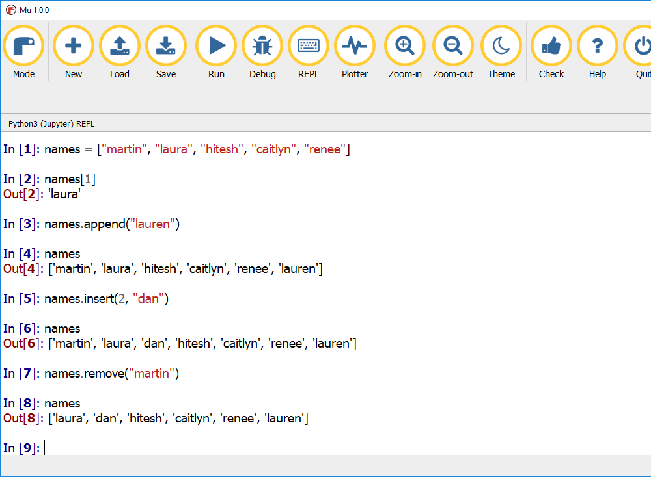

Slide 22
Looping through a List
You are going to use iteration and lists to create a program which will create and display a shopping list for you. You will create this program in two parts: one to displaying the shopping list, and another to create it. Your challenge will be to combine these two programs together.
We’ll start with the code to display the shopping items. The first step is to create a program which will loop through all the items in a list and print them to the screen.
Create a new program and save it as display_shopping. Note: If you are unsure how to do this, take a look at the “If it’s this, then do that” lesson.

Slide 23
Create a list variable for your shopping and fill it with some items.
To loop through each of the items in the list, you will use a for loop. for loops exist in most programming languages, and their purpose is to allow code to be run a set number of times – in our case, equal to the number of things in our shopping list.

Slide 24


The syntax of a for loop in Python looks like this:
Use a for loop to print out each of the items in your shopping list.
Note: The print statement is indented under the for loop. Indentation in a for loop works exactly the same as in an if statement; whatever code is indented under the for is run as part of that loop.
Run your program.

Slide 25


Code
Output

Slide 26
Breaking it down
Let’s break this down and consider what steps the computer takes to carry out this program.
First it creates the list called shopping.
shopping = ["bread", "cheese", "apple", "tomato", "biscuits"]
The for loop is entered. The first element in the shopping list, "bread", is put into the variable item.
for item in shopping:
print is used to display what is in the variable item.
print(item)

Slide 27
item holds the value “bread”, so “bread” is printed.
bread
The for then runs again and the second element in the shopping list, "cheese" is put into the variable item.
for item in shopping:
print is used to display what is in the the variable item.
print(item)
This time, item holds the value “cheese”, so “cheese” is printed.
Cheese
The for loop runs again and the third element, "apple", is put into the variable item.
for item in shopping:
This continues until there are no more items in the list. Each item has been printed in turn, and then the for loop stops.

Slide 28
Counting
A really useful coding technique is being able to count as your loop runs. That way you will know how many times your loop has run. In your shopping list program, you can use this to print out how many items are in your list at the end of your program. To keep track of how many items are in your list, you will need to create a variable which will hold a running total of the number of items.

Slide 29
Create a variable called count at the top of the display_shopping program and set it to zero: count = 0
Indented under your for loop, add 1 to the count variable. count = count + 1
When the computer runs this line of code it does it in the following order: 1. count + 1 is evaluated first: the computer calculates the current value of count plus 1. 2. Next the computer sets the value of count to the result of step 1. 3. count is now equal to ‘whatever it was before’, plus 1.

Slide 30
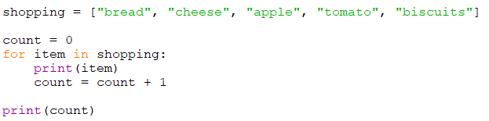
Now let’s print out how many items are in the shopping list.
At the end of your program, not indented under the for, print the value of count. print(count)
Your complete code should now look similar to this:

Slide 31
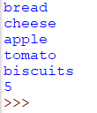
Run your program and check that the count is the same as the number of items in your shopping list.

Slide 32
Challenge
Improve the message so that it prints “you have X items in your shopping list”, inserting the value from the count variable.
Tip: Counting is a widely-used and really useful technique. However, in this instance, there is an easier way to find out how many items are in a list, using the function len, which is short for “length”. For example, len(shopping)

Slide 33
Looping a set number of times
Being able to run the same piece of code a number of times can be really useful. Say you want to capture 11 names for a football team, or the lengths of the sides in a triangle. You can do this by adjusting the way you use a for loop.
To do something five times, you could create a for loop which looped for all the numbers between 0 and 4 by creating a list of those numbers. For example, numbers = [0,1,2,3,4] for number in numbers: print(number) However, this very restrictive. It will only ever be able to loop five times, and what if you want to do something a million times? It wouldn’t be feasible to create a list with every number up to 1,000,000.

Slide 34

To overcome this issue, Python has a function called range which will create a list of numbers for you. By using range we can simplify the example program on the last slide:
Note: - range(5) will create a list of five numbers from 0 to 4, not six numbers from 0 to 5.

Slide 35
You will now use a for loop with range to create a program which will loop for a set number of times asking the user for an item of shopping and then appending it to the shopping list variable.
Create a new program and save it as create_shopping.
Create an empty list variable called shopping. shopping = []
Add a for loop with a range to loop 5 times. for item_number in range(5):

Slide 36
Indented under the for loop, use input to ask the user for something to go on the shopping list: item = input("what is the item? ")
Still indented under the for loop, append the item to the shopping list. shopping.append(item)
Finally, after the for loop let’s print the shopping list, so we can see what is in it. print(shopping)

Slide 37
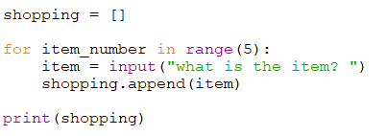
The complete create_shopping program should now look similar to this:

Slide 38
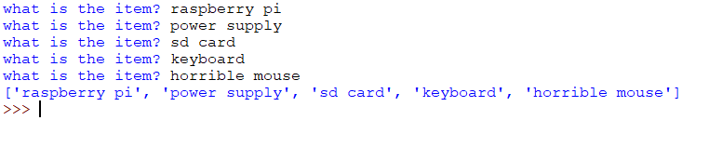
Run your program and make sure you can enter 5 items of shopping and that they are displayed at the end.

Slide 39
At each stage, the variable item_number will contain the number of the times the program has been around the for loop, starting at 0 and going up to 4. Let’s make this more apparent.
Change your program to include each item_number in the corresponding prompts to the user for shopping items.
Run your program so you can see this displaying each item_number.

Slide 40
What do you notice about the item numbers?
Do humans start by numbering their first item as item 0?
Try this instead

Slide 41
At the moment your program will only ever collect 5 items of shopping. What if you have more or less? In the next step you will change the program so that it starts by asking the user how many items of shopping they need, and use that number in your for loop.
Add to the top of your program an input to get the number of items of shopping.

Slide 42
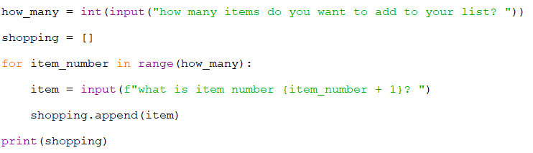
Now change the for loop so that the variable how_many is used by range. for item_number in range(how_many):
Your program should now look similar to this:
Run your program and enter a number of items.

Slide 43
Portfolio 7: Make and Print List
Now you have one program which will print items one at a time and one that will make a list. Your challenge is to combine them together to create a program which will:
Ask how many items are needed.
Collect the items and store them in a list.
Loop through the shopping list and display them.
Show a total at the end so the user can see how many have been added.
Save your file as your_name_u3_port_7

Slide 44
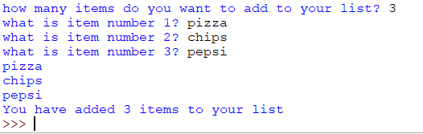
Sample output for portfolio 7

Slide 45
Calculating Averages
Now you have learned how to use loops, you will use these new skills to update your bot so it calculates an average (or mean). To do this, your bot will need to: 1. Capture how many numbers you wish to average 2. Loop that many times, capturing the numbers 3. Keep a running total of the numbers 4. When the loop has finished divide the total by the number of numbers

Slide 46
Open your bot 2 program.
Add a new command to your bot by adding a new elif to test for a new “average” command.
Note: the elif should be inline with the if and other elifs. It has to go before the else:

Slide 47
Indented under the new elif, use input to capture how many numbers are to be averaged.
Create a variable called total which will be used to keep a total of the numbers entered, and set it to 0. total = 0
Using for and range, loop as many times as there are numbers to get.

Slide 48

Capture the numbers from the user using input and add the value to the total variable.
Note: these lines of code are indented two levels, once under the elif and again under the for.
After the for loop you need to add the code to calculate the result and print the result.

Slide 49
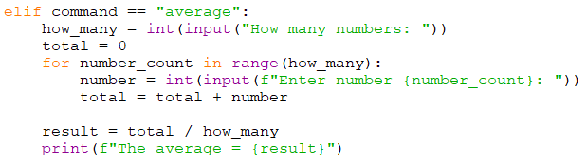
Note: Make sure your indents are correct, as there are multiple levels of indentation in this program. Your code should be structured similar to this:
Run your new bot program and calculate the average from a list of numbers.

Slide 50
Challenges: Add a New Commands to Bot 2
It’s now your turn to add a new command to your bot. It should be something which you would find helpful.
Here are a few ideas to help get you started:
include the shopping list creator into your bot
add up the cost of your shopping
calculate a discount
divide the cost of a meal in a restaurant

